Slide 1
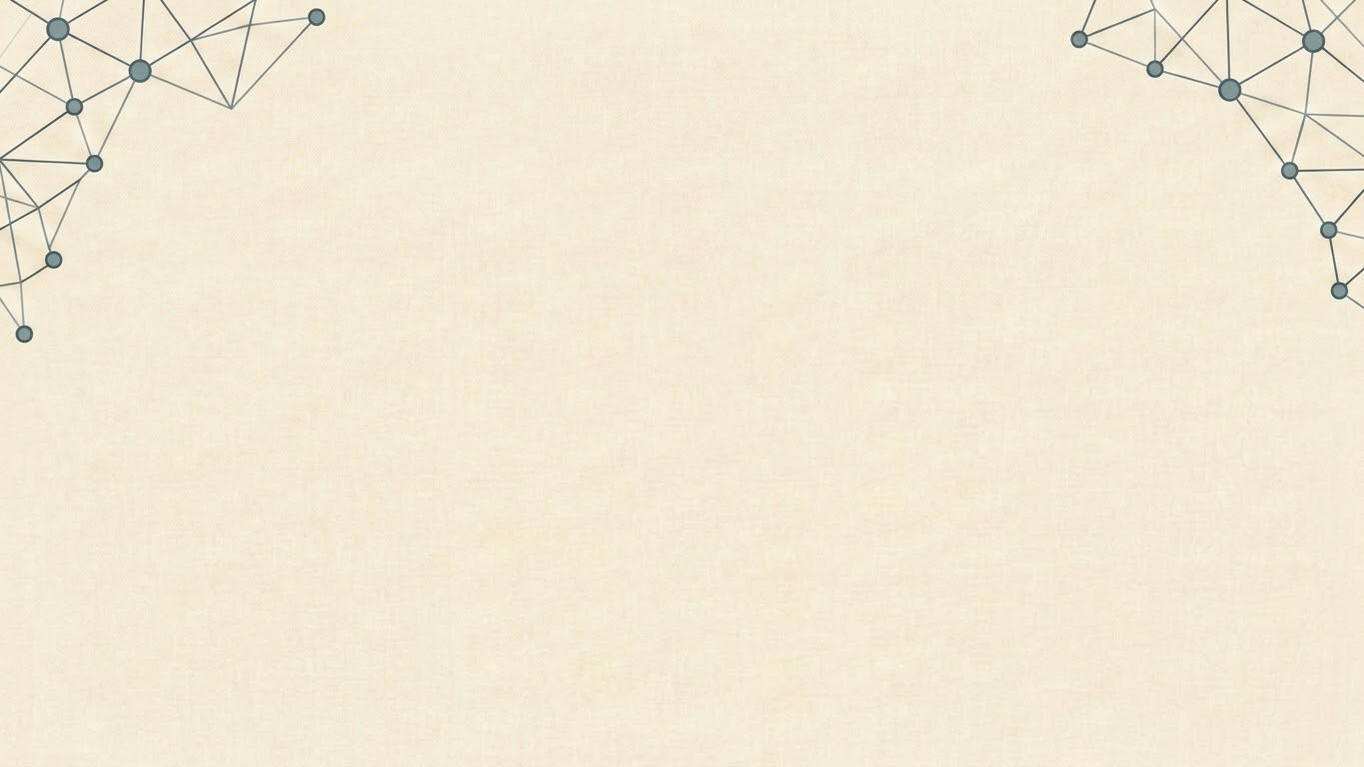
How AI Evolved: From Rules to Reasoning.
By:Mohammad Raza

Slide 2
Topics to be covered:
Introduction to Artificial Intelligence (AI)
History of Data Science
Rule-Based Systems (Expert Systems)
Limitations of Rule-Based Systems
Introduction to Machine Learning (ML)
Types of Machine Learning
Supervised Learning
Unsupervised Learning
Reinforcement Learning
Real-World Applications of Machine Learning
Deep Learning and Neural Networks
Computer Vision and Natural Language Processing (NLP)
The Transformer Revolution
Large Language Models (LLMs)
Generative AI
AI Agents and Autonomous Systems
Conclusion & Key Takeaways

Slide 3
History of Data Science
1950s–1960s: Birth of Data Analysis
Data analysis was performed using statistics and mathematics.
Businesses and governments used statistical methods for decision-making.
Computers began assisting with data processing.
1970s: Database Revolution
Development of Relational Database Management Systems (RDBMS).
Structured data could be stored, organized, and queried efficiently.
SQL became the standard language for managing databases.
1990s: Data Mining Era
Organizations started collecting large volumes of digital data.
Data Mining techniques were developed to discover hidden patterns and trends.
Businesses used data for customer analysis, fraud detection, and market research.

Slide 4
History of Data Science
2001: Data Science Emerges
William S. Cleveland proposed expanding statistics into a new discipline called Data Science.
Data Science combined statistics, computer science, and domain expertise to extract insights from data.
2010s: Big Data & Machine Learning
Massive growth of data from the internet, smartphones, and social media.
Technologies like Hadoop and Spark enabled processing of Big Data.
Machine Learning became widely adopted for predictive analytics and automation.
2020s: AI & Generative AI
Deep Learning and Large Language Models transformed Data Science.
Data Scientists began using AI for automation, prediction, and content generation.
Modern Data Science integrates Machine Learning, Deep Learning, Generative AI, and AI Agents.

Slide 5
Introduction to Artificial Intelligence (AI)
Artificial Intelligence is the science and engineering of creating machines capable of performing tasks that typically require human intelligence.
AI enables machines to learn, reason, solve problems, understand language, perceive images, and make decisions.
AI combines multiple fields, including Machine Learning, Deep Learning, Natural Language Processing (NLP), Computer Vision, and Robotics.
AI is transforming industries such as healthcare, finance, education, manufacturing, transportation, and entertainment.
.
Modern AI systems can analyze vast amounts of data, identify patterns, and continuously improve their performance.

Slide 6
Rule-Based Systems (Expert Systems)
Definition:
Rule-Based Systems are one of the earliest forms of Artificial Intelligence.
They make decisions using predefined IF–THEN rules created by human experts.
These systems do not learn from data; they strictly follow programmed logic.
Commonly used for solving well-defined problems with clear rules.

Slide 7
Rule-Based Systems (Expert Systems)
How They Work:
Receive an input from the user or environment.
Compare the input against a knowledge base of rules.
An inference engine evaluates the matching rules.
Produce an output or decision based on the applicable rule.
Example:
IF Temperature > 38°C
THEN Patient has a Fever

Slide 8
Rule-Based Systems (Expert Systems)
Advantages:
Easy to understand and explain.
Fast and consistent decision-making.
Reliable for repetitive and well-defined tasks.
Does not require training data.
Limitations:
Cannot learn from new experiences.
Requires manual updates when rules change.
Difficult to scale as the number of rules increases.
Performs poorly with uncertain or complex problems.

Slide 9
Rule-Based Systems (Expert Systems)
Use Case 1: Medical Diagnosis Expert System
Example: MYCIN (1970s)
Summary:
Doctors entered a patient's symptoms into the system.
The expert system applied IF–THEN rules from medical experts to identify possible bacterial infections.
It also recommended suitable antibiotics based on predefined medical knowledge.
This helped doctors make faster and more consistent decisions, especially in complex cases.
Example Rule:
IF Patient has Fever
AND White Blood Cell Count is High
THEN Possible Bacterial Infection

Slide 10
Rule-Based Systems (Expert Systems)
Use Case 2: Banking Loan Approval
Summary:
Banks use rule-based systems to evaluate loan applications.
The system checks predefined conditions such as credit score, income, employment status, and existing debt.
Based on these rules, the application is approved, rejected, or sent for manual review.
This speeds up decision-making and ensures consistent application of lending policies.
Example Rule:
IF Credit Score > 750
AND Annual Income > ₹10,00,000
THEN Approve Loan

Slide 11
Introduction to Machine Learning (ML)
Definition:
Machine Learning (ML) is a subset of Artificial Intelligence that enables computers to learn from data without being explicitly programmed.
Instead of relying on predefined rules, ML algorithms identify patterns and make predictions based on experience.
The more quality data the model is trained on, the better its performance becomes.
ML is widely used for prediction, classification, recommendation, and automation.

Slide 12
Types of Machine Learning
Supervised Learning:
Definition: Learns from labeled data to predict outcomes or classify new data.
Popular Algorithms:
Linear Regression
Decision Tree
Random Forest
Example: Email spam detection, house price prediction.

Slide 13
Types of Machine Learning
Unsupervised Learning:
Definition: Learns from unlabeled data to discover hidden patterns or group similar data.
Popular Algorithms:
K-Means Clustering
DBSCAN
Principal Component Analysis (PCA)
Example: Customer segmentation, anomaly detection.

Slide 14
Types of Machine Learning
Reinforcement Learning
Definition: Learns by interacting with an environment and receiving rewards or penalties for its actions.
Popular Algorithms:
Q-Learning
Deep Q Network (DQN)
Proximal Policy Optimization (PPO)
Example: Self-driving cars, robotics

Slide 15
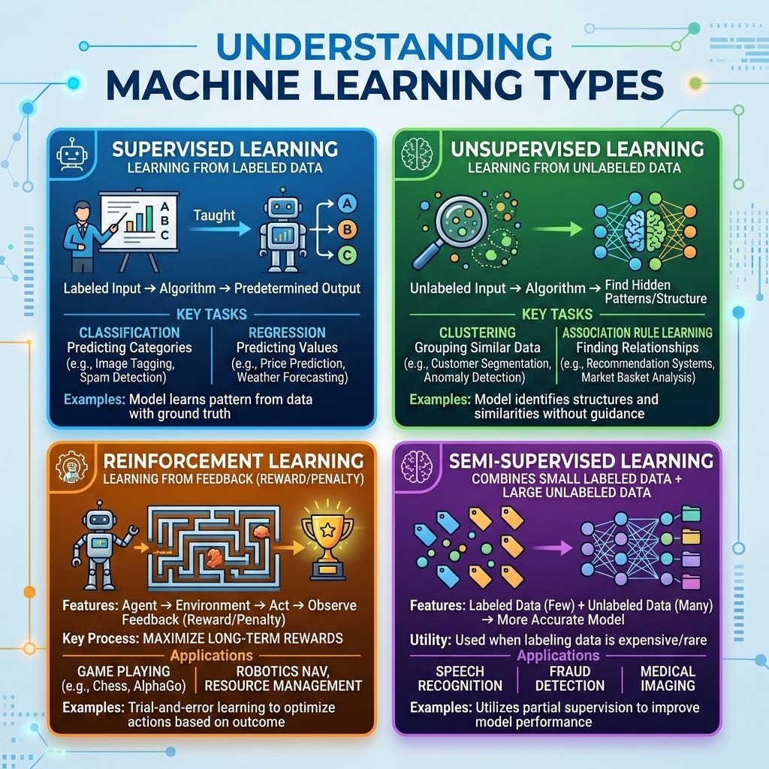
Types of Machine Learning

Slide 16
Deep Learning and Neural Networks
What is Deep Learning?
Deep Learning is a subset of Machine Learning that uses Artificial Neural Networks (ANNs) with multiple hidden layers to learn complex patterns from large amounts of data.
It can automatically extract features without manual programming.
Deep Learning excels at tasks involving images, speech, text, and video.
What is a Neural Network?
A Neural Network is a computational model inspired by the structure of the human brain.
It consists of interconnected neurons (nodes) that process information.
Each neuron receives input, performs calculations, and passes the output to the next layer.

Slide 17
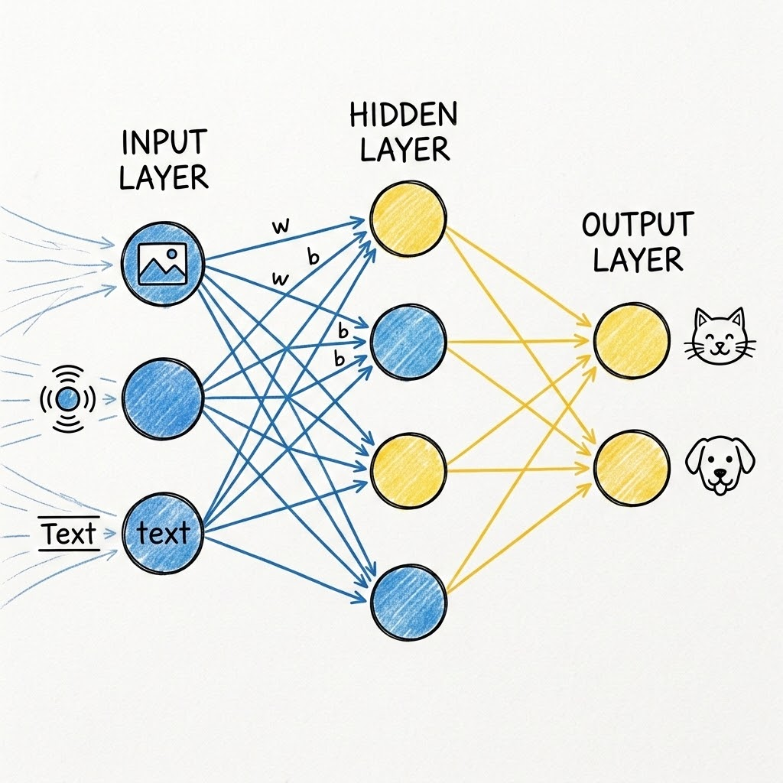
Deep Learning and Neural Networks

Slide 18
Deep Learning and Neural Networks
Popular Deep Learning Algorithms:
Convolutional Neural Network (CNN) – Image Recognition
Recurrent Neural Network (RNN) – Sequential Data & Time Series
Long Short-Term Memory (LSTM) – Language & Speech Processing
Transformer – Natural Language Processing (ChatGPT, Gemini, Claude)

Slide 19
Deep Learning and Neural Networks
Advantages:
Learns complex features automatically.
High accuracy on large datasets.
Handles images, audio, text, and video effectively.
Powers modern AI applications such as ChatGPT and autonomous vehicles.
Limitations:
Requires large amounts of training data.
Computationally expensive.
Training can take hours or days.
Often difficult to interpret ("black box" models).

Slide 20
Deep Learning and Neural Networks
Use Case: Face Recognition (Face ID)
Application:
Deep Learning powers Face Recognition systems used in smartphones, airports, and security systems.
How It Works:
A Convolutional Neural Network (CNN) is trained on millions of facial images.
The model learns unique facial features such as the eyes, nose, mouth, and facial structure.
When a user looks at the camera, the system compares the captured face with the stored face and verifies the identity.

Slide 21
Computer Vision and Natural Language Processing
Computer Vision:
Definition:
Computer Vision is a field of AI that enables computers to understand, analyze, and interpret images and videos.
Key Applications:
Face Recognition
Object Detection
Medical Image Analysis
Autonomous Vehicles
Quality Inspection in Manufacturing

Slide 22
Computer Vision and Natural Language Processing
Popular Algorithms/Models:
Convolutional Neural Network (CNN)
YOLO (You Only Look Once)
Vision Transformer (ViT)

Slide 23
Computer Vision and Natural Language Processing
Definition:
Natural Language Processing (NLP) enables computers to understand, interpret, and generate human language in text or speech.
Key Applications:
Machine Translation
Chatbots & Virtual Assistants
Sentiment Analysis
Text Summarization
Speech Recognition
Popular Algorithms/Models:
BERT
GPT (Generative Pre-trained Transformer)
Transformer

Slide 24
The Transformer Revolution
What is a Transformer?
The Transformer is a deep learning architecture introduced by Google in 2017.
It revolutionized Natural Language Processing (NLP) by processing words in parallel rather than one at a time.
Transformers use an Attention Mechanism to identify the most important words in a sentence.
It became the foundation for modern Large Language Models (LLMs) such as ChatGPT, Gemini, Claude, and Llama.
Why Was It Revolutionary?
Faster training through parallel processing.
Better understanding of long-range context in text.
Higher accuracy than previous RNN and LSTM models.
Scales efficiently to billions of parameters.

Slide 25
The Transformer Revolution
Key Innovation:
Attention Mechanism:
Allows the model to focus on the most relevant words when understanding or generating text.
Improves context awareness and language understanding.
Popular Transformer Models:
BERT – Language understanding and search.
GPT – Text generation and conversational AI.
T5 – Translation, summarization, and question answering.

Slide 26
The Transformer Revolution
Real-World Use Case: Google Translate
Application:
Google Translate uses Transformer models to provide fast and accurate translations across hundreds of languages.
How It Works:
The Transformer analyzes the entire sentence at once, understands the context, and generates a natural translation instead of translating word by word.
Benefits:
More accurate translations.
Better handling of grammar and sentence structure.
Supports real-time translation for websites, documents, and conversations.

Slide 27
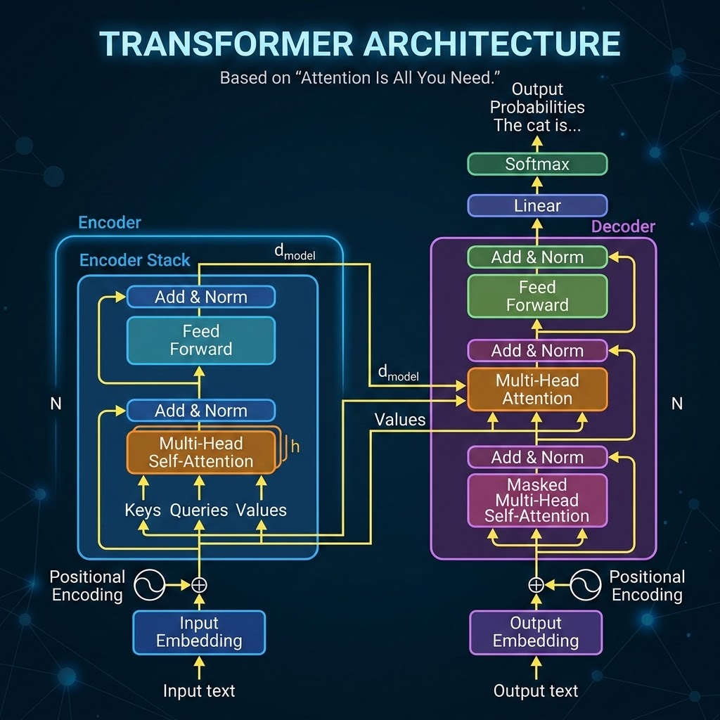
The Transformer Revolution

Slide 28
Large Language Models (LLMs)
What are Large Language Models?
Large Language Models (LLMs) are AI models trained on massive amounts of text data to understand and generate human language.
They are built using the Transformer architecture and contain billions of parameters.
LLMs can perform a wide range of language tasks without task-specific programming.
They power modern conversational AI, coding assistants, and content generation tools.
Example:Chatgpt,Gemini,Claude,Grok

Slide 29
Generative AI
What is Generative AI?
Generative AI is a branch of Artificial Intelligence that can create new content such as text, images, audio, video, and code.
It learns patterns from large datasets and generates original content based on user prompts.
Most modern Generative AI models are built on Large Language Models (LLMs) and the Transformer architecture.
It is widely used to automate creative and knowledge-based tasks.
Example:Chatgpt,Gemini,Claude,Stable Diffusion

Slide 30
AI Agents
What are AI Agents?
AI Agents are intelligent systems that can perceive, reason, plan, and take actions to achieve a specific goal with minimal human intervention.
Unlike traditional AI, AI agents can make decisions, use tools, and adapt based on feedback.
They can automate complex workflows by breaking tasks into smaller steps and executing them independently.
Modern AI agents are often powered by Large Language Models (LLMs).

Slide 31
AI Agents
Popular AI Agent Frameworks
LangGraph
AutoGen
CrewAI
OpenAI Agents SDK
Examples:
OpenAI Codex Agents
Claude Code
GitHub Copilot Agent
Cursor AI

Slide 32
Conclusion
“Artificial Intelligence has evolved from rule-based systems to intelligent models that can learn, reason, and generate content. Despite these advances, AI is not perfect and still requires human oversight, critical thinking, and ethical guidance. The future of AI is a collaborative partnership where humans and AI work together to solve complex problems more efficiently and responsibly.”

Slide 33
Any Questions?

